Slide 1

Student Management System
S
M
S

Slide 2
Overview
Student Management System (SMS) is a solution tool that is designed to track, maintain and manage all the data generated by a School, including the grades of a student, their attendance, grades etc. We have tried to make a terminal based program facilitating the same.
These are entities used in our Student Management System- Registrar, Student, Professor, Course.
Registrar enrolls and manages students and professors. Each Admin would have an Admin ID, Name, Email, and Password stored in a database.
A Student will have a student id, name, Email, semester, department and a password.
A Professor will have a professor ID, Name, Email, department, and password.
A Course has a course id, name, credit, no_of _classes and Professor ID who is teaching that course.

Slide 3
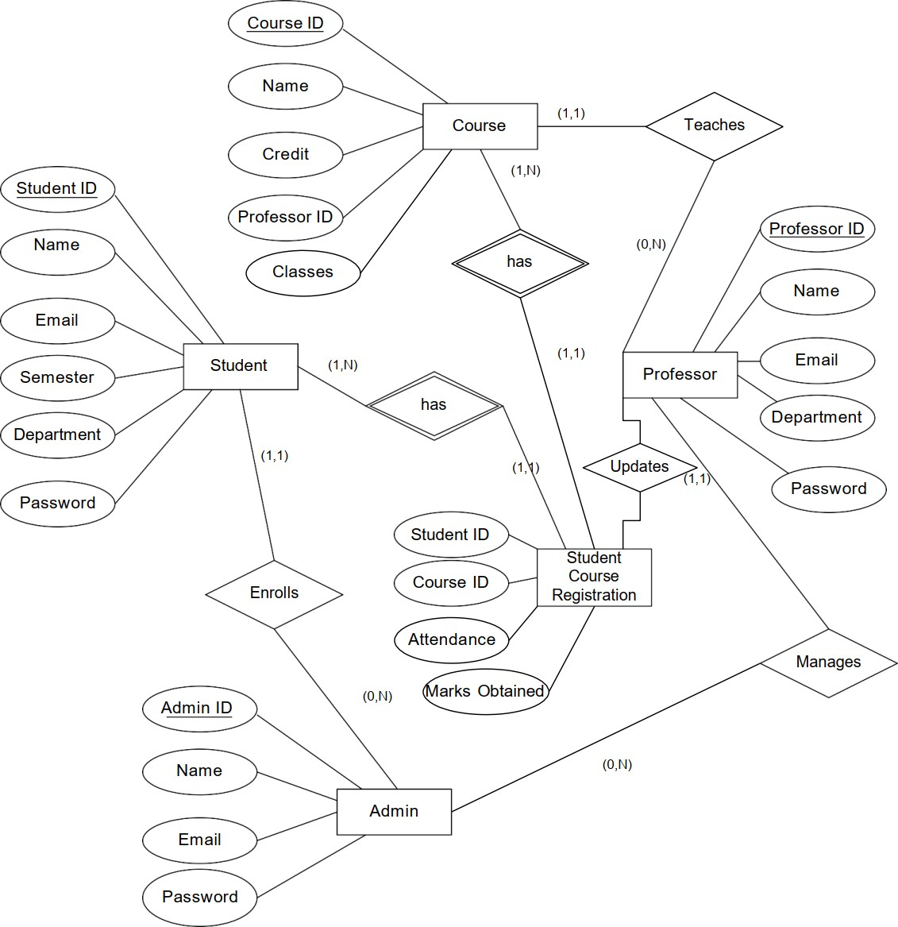
Solution
Relationships & Functionalities:
A Course is taught by a Professor and a Professor may or may not teach a course.
A Student can be enrolled in one or more Courses
There should be at one and only one Professor teaching a Course .
Professor can update attendance and marks of a particular student for a particular course. We are providing C++ & SQL based program where a user (Registrar, Student and Professors) can login using their ID’s and passwords which will be matched from the database. Upon successful login, Admin can onboard students and professors , add a course and register a student to a particular course. Each students can view the offered courses and request registrar to get him registered for the course. Professor updates the attendance of the students for the course they are teaching. Student can view their registered courses, attendance and marks. Professor can also update the attendance .

Slide 4

Tech Stack
C++
The project we are delivering is a terminal based project. We are using C++ language to deliver our project.
Sqlite3
SQLite is a self-contained, high-reliability, embedded, full-featured, public-domain, SQL database engine. It is the most used database engine in the world. It is an in-process library and its code is publicly available. It is free for use for any purpose, commercial or private
SQL
SQL stands for Structured Query Language SQL lets you access and manipulate databases. We are creating a database along with relevant tables and performing SQL operations on the database with the help of C++ language.

Slide 5
TABLES
Registrar
Professor
student
Brief : Creates a registrar table which will store information of all the registrars.
Attributes : id,name,email,password
Brief : Creates a professor table which will store information of all the professor.
Attributes : id,name,email,password,department
Brief : Creates a student table which will store information of all the students.
Attributes : id,name,email,password,semester,department
Course
sturegist
Brief : Creates a course table which will store information of all the courses.
Attributes : id,name,credit,prof_id,no.of classes
Brief : Table which stores the data regarding student registration to different courses , his marks and attendance in the same.
Attributes : courseid,studentid,attendance,marks

Slide 6
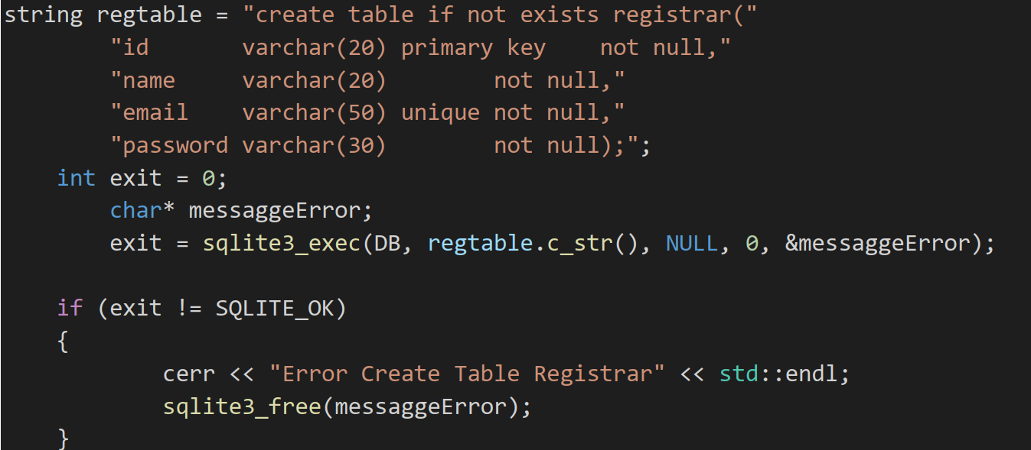
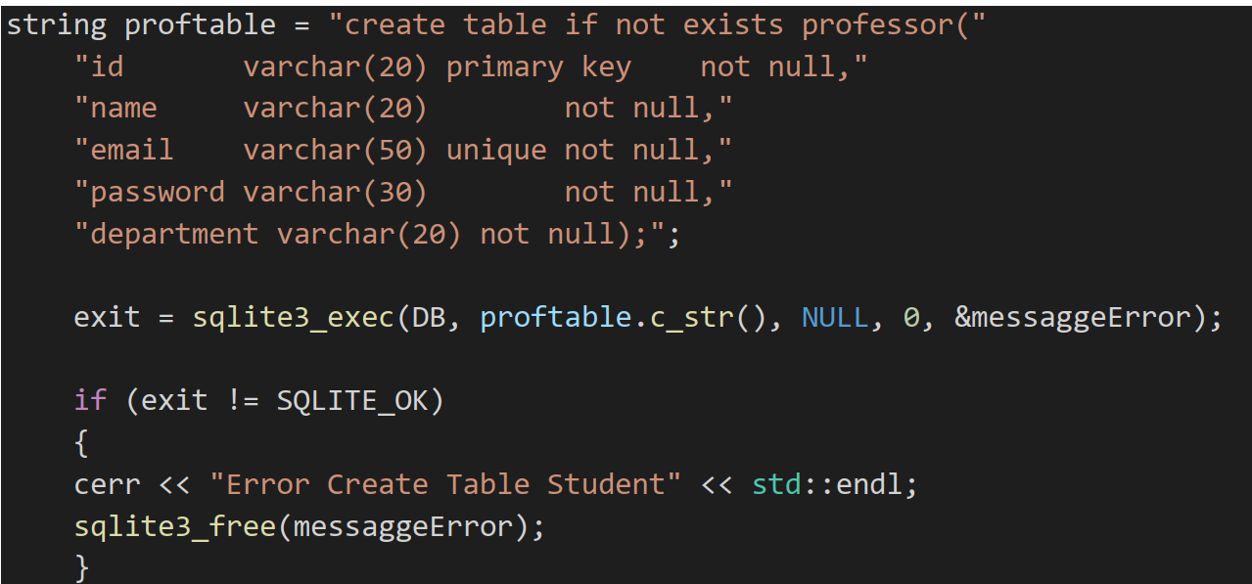
TABLES
REGISTRAR
professor

Slide 7
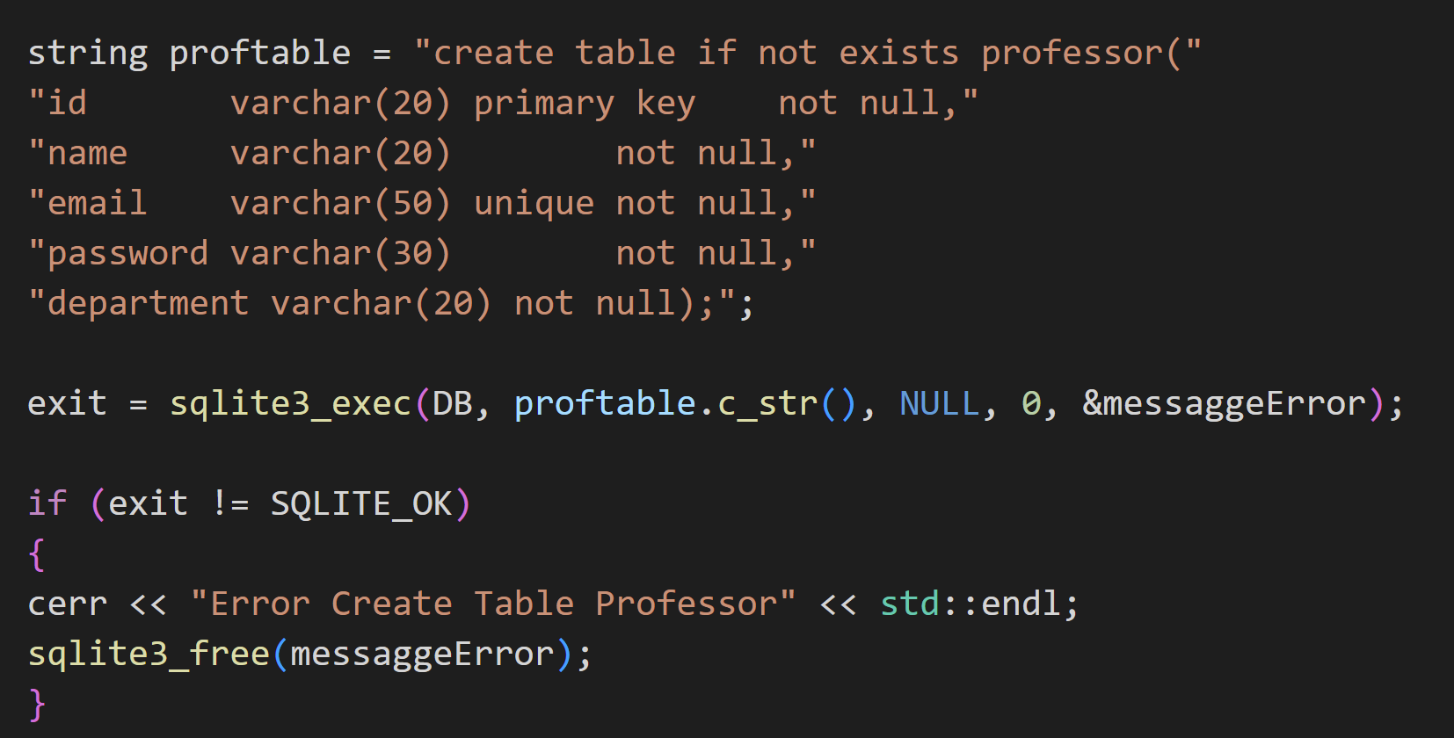
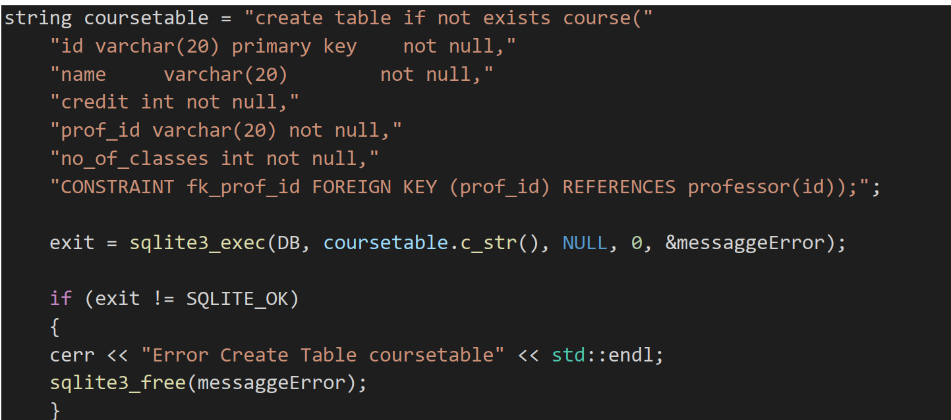
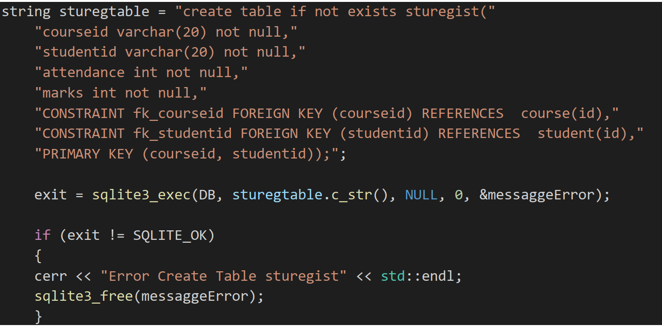
TABLES(CONTD.)
STUDENT
COURSE
STUREGIST
COURSE

Slide 8

FUNCTIONS Accessed by registrar

Slide 9
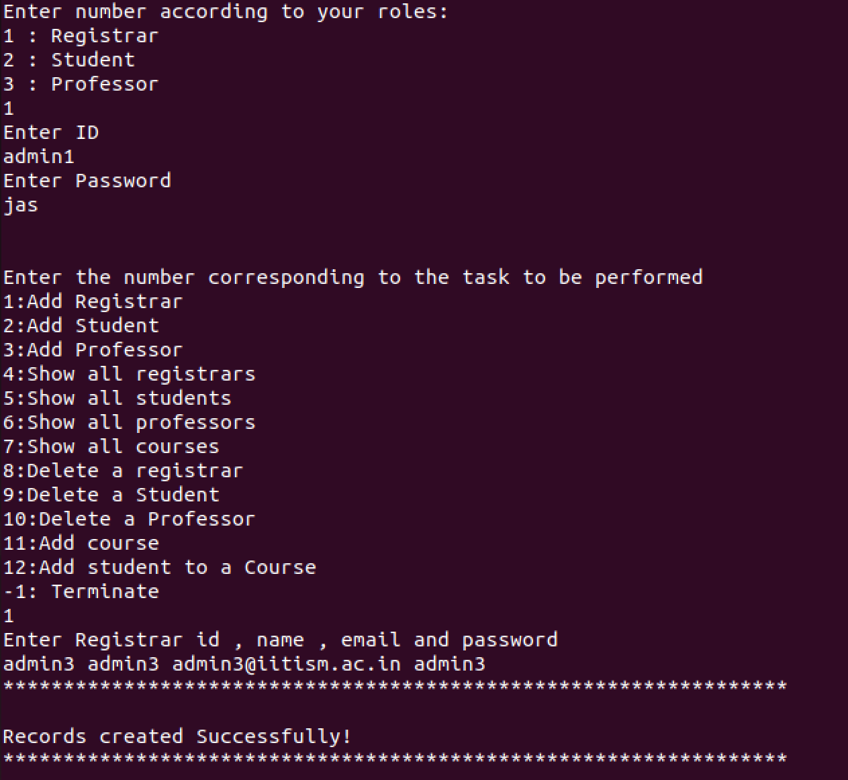
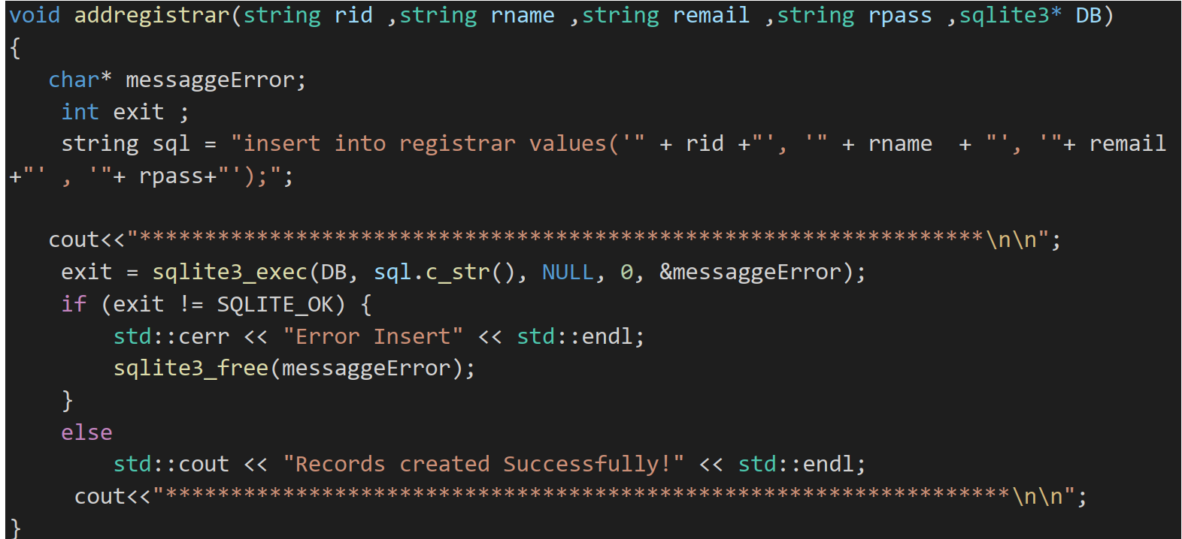
1. Add Registrar
Here, the registrar id, name, email and password are passed as a parameter
This data is being inserted in the table. Here is the code snippet:
Sample Output

Slide 10
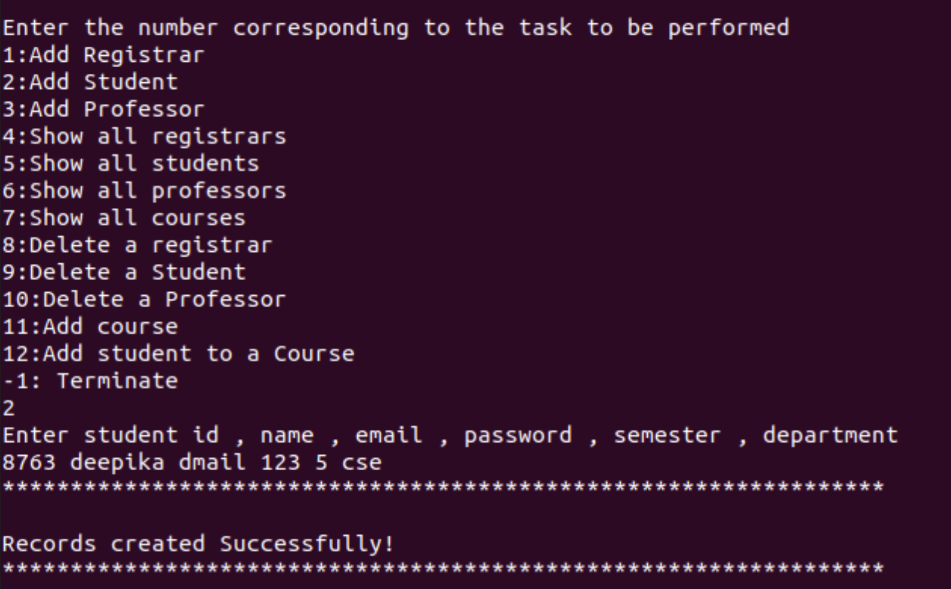
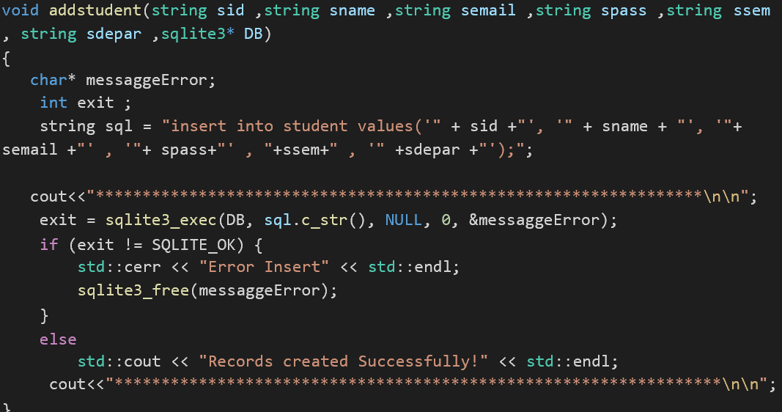
2. Add student
Here, student id, name, email, password, semester and department are passed as a parameter. This data is being inserted in the table.
Sample Output

Slide 11
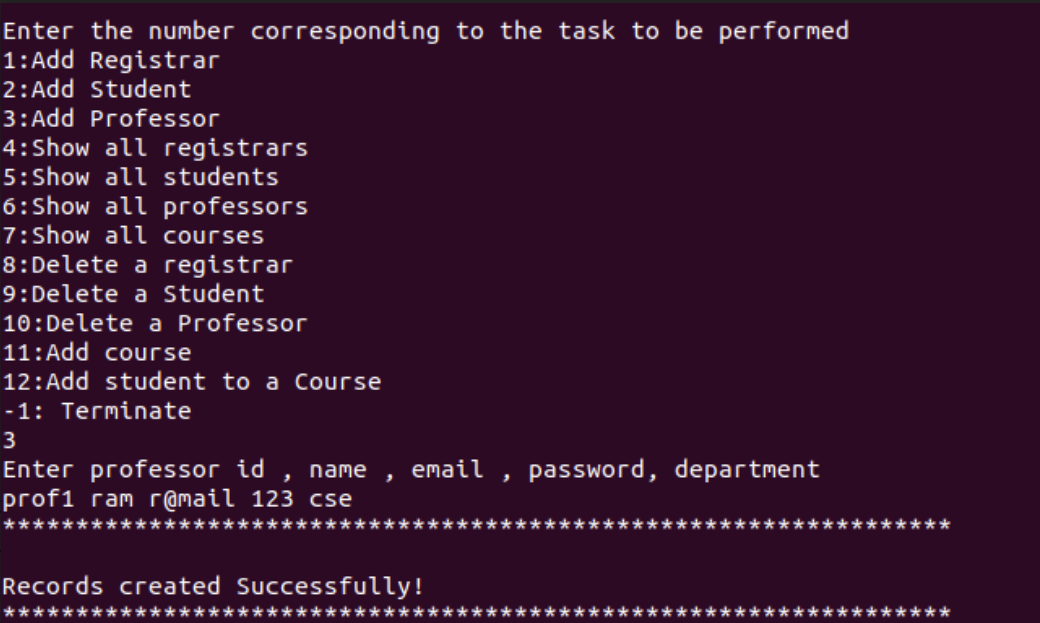
3. Add Professor
Here, professor id, name, email, password and department is passed as parameter. This data is being inserted in the table. The following code is used to do this process:
Sample Output
void addprof(string pid ,string pname ,string pemail ,string ppass , string pdepar
,sqlite3* DB)
{
char* messaggeError; int exit ;
string sql = "insert into professor values('" + pid +"', '" + pname + "', '"+ pemail +"' , '"+ ppass+"' , '" +pdepar +"');";
cout<<"*****************************************************************\n\n"; exit = sqlite3_exec(DB, sql.c_str(), NULL, 0, &messaggeError);
if (exit != SQLITE_OK) {
std::cerr << "Error Insert" << std::endl; sqlite3_free(messaggeError);
}
else
std::cout << "Records created Successfully!" << std::endl; cout<<"*****************************************************************\n\n";
}

Slide 12
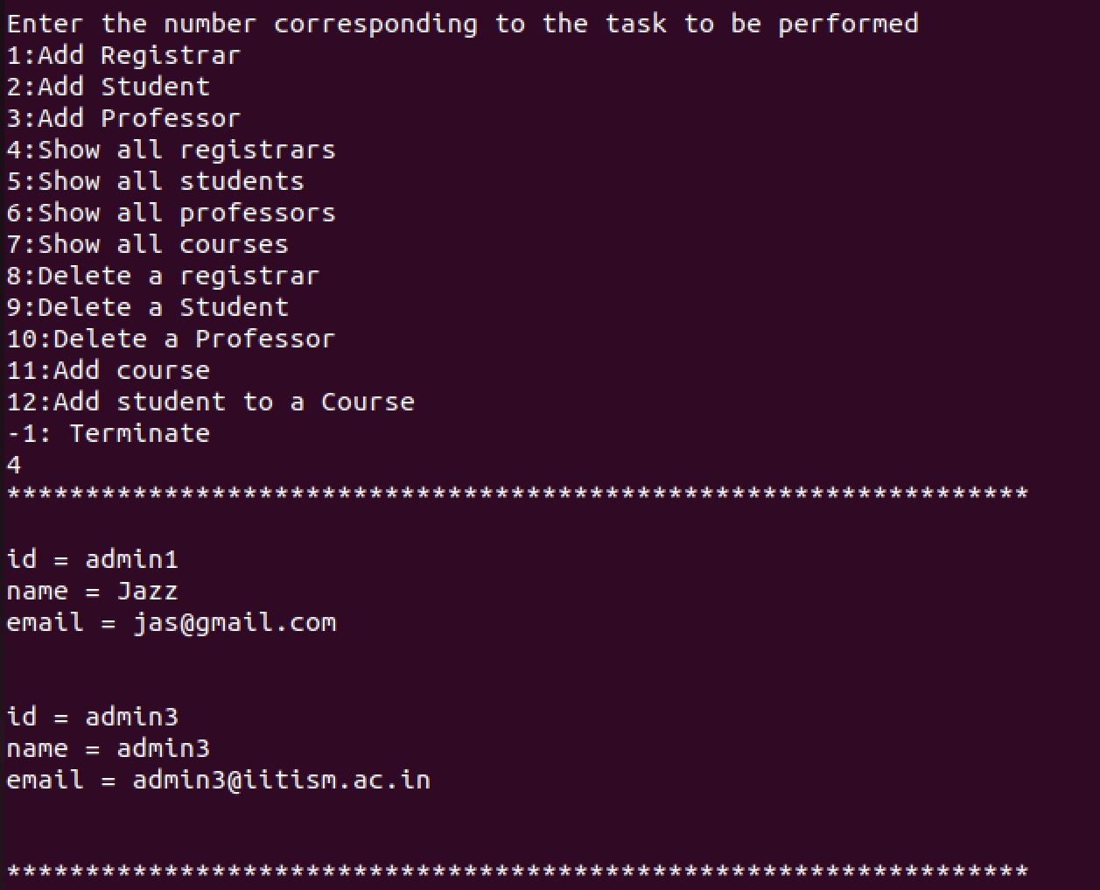
4. Show all Registrars
This shows all the registrar details to current registrar:
Sample Output
void showregistrar(sqlite3* DB)
{
string query = "select id,name,email from registrar;"; cout<<"*****************************************************************\n\n"; sqlite3_exec(DB, query.c_str(), callback, NULL, NULL); cout<<"*****************************************************************\n\n";
}

Slide 13
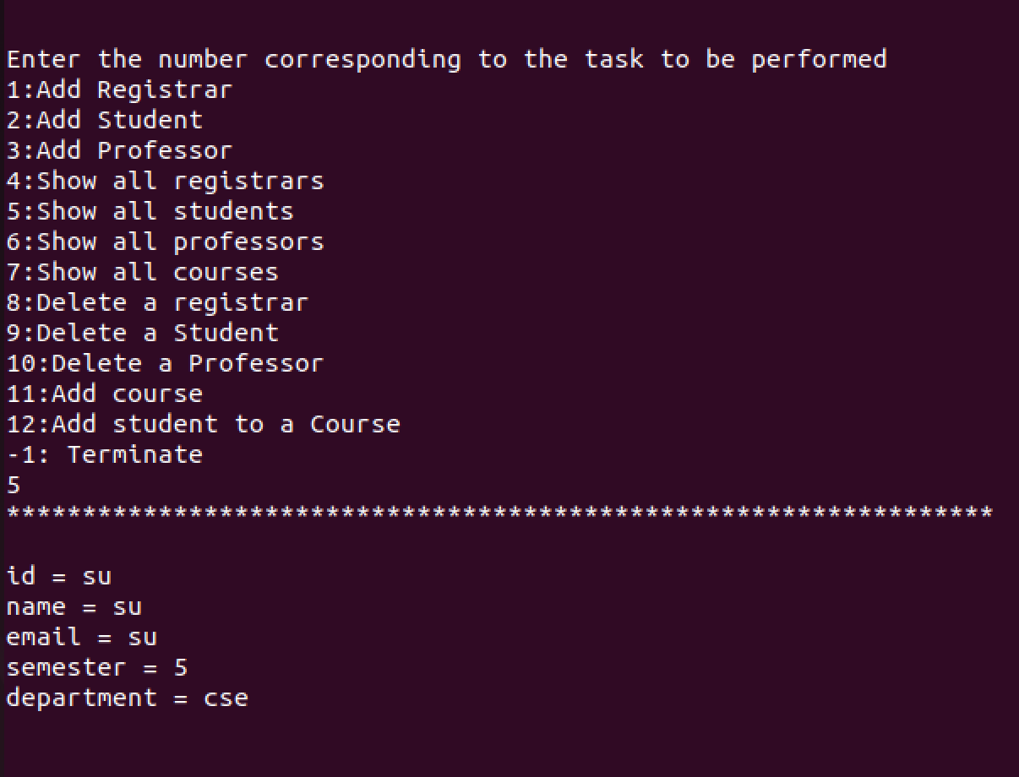
5. Show all students
The current registrar is shown data of all the students:
Sample Output
void showstudent(sqlite3* DB)
{
string query = "select id,name,email,semester,department from student;"; cout<<"*****************************************************************\n\n"; sqlite3_exec(DB, query.c_str(), callback, NULL, NULL); cout<<"*****************************************************************\n\n";
}

Slide 14
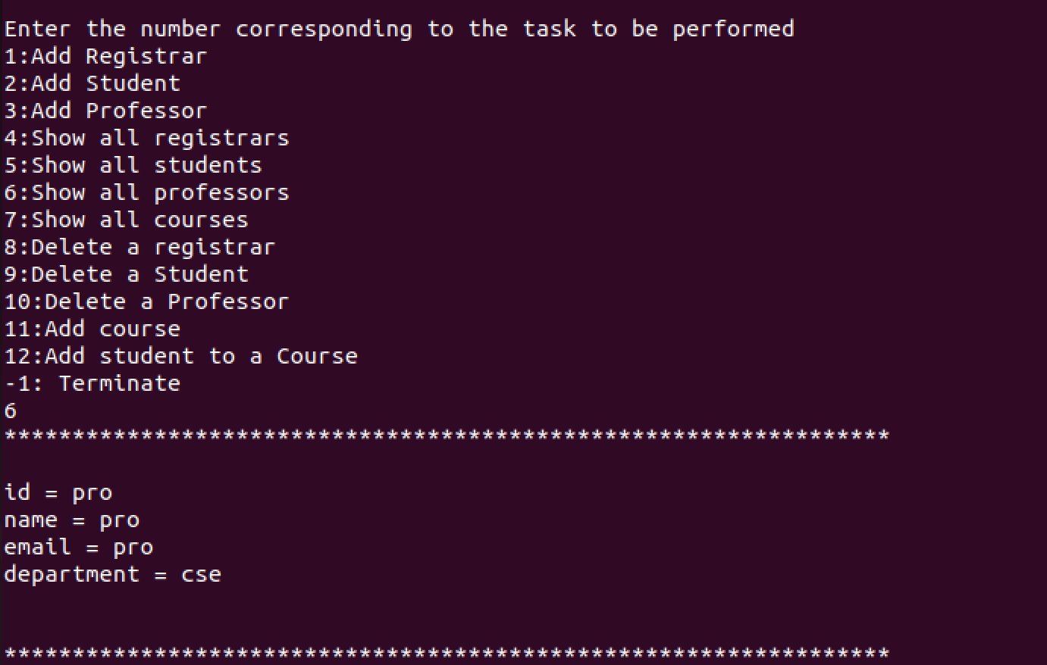
6. Show all professors
Details of all the professors is shown to current registrar.
Sample Output
void showprof(sqlite3* DB)
{
string query = "select id,name,email,department from professor;"; cout<<"*****************************************************************\n\n"; sqlite3_exec(DB, query.c_str(), callback, NULL, NULL); cout<<"*****************************************************************\n\n";
}

Slide 15
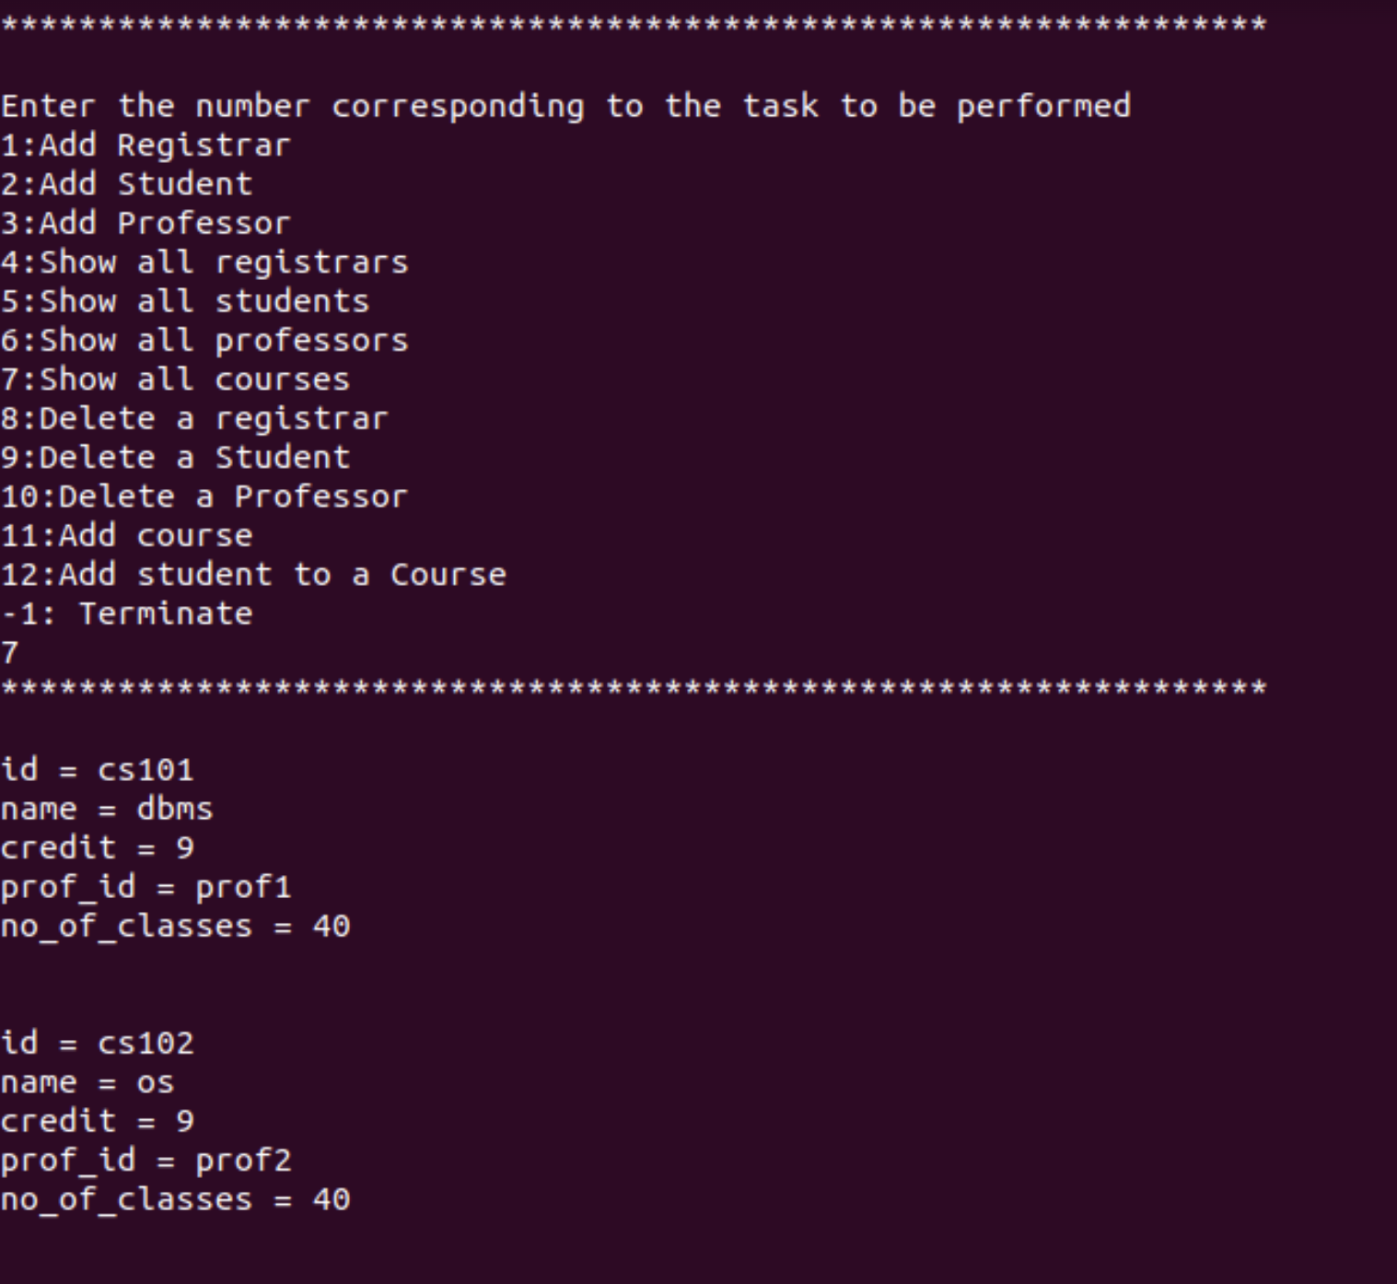
7. Show all courses
All the offered courses are shown to the logged in registrar.
Sample Output
void showcourses(sqlite3* DB)
{
string query = "select * from course;"; cout<<"*****************************************************************\n\n"; sqlite3_exec(DB, query.c_str(), callback, NULL, NULL); cout<<"*****************************************************************\n\n";
}

Slide 16
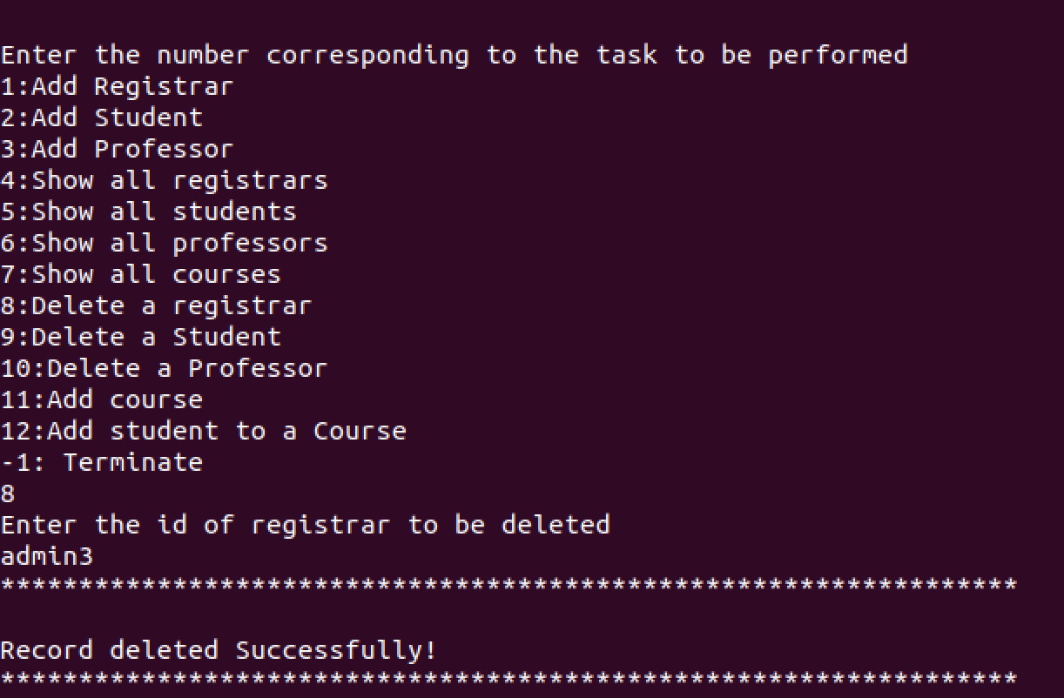
8. Delete a registrar
This function deletes the registrar with a unique rid from the registrar table.
Sample Output
void deleteregist(string rid , sqlite3* DB)
{
int exit;
char* messaggeError; cout<<"*****************************************************************\n\n"; string sql = "delete from registrar where id = '" + rid+"';";
exit = sqlite3_exec(DB, sql.c_str(), NULL, 0, &messaggeError); if (exit != SQLITE_OK) {
std::cerr << "Error DELETE" << std::endl;
sqlite3_free(messaggeError);
}
else
cout << "Record deleted Successfully!\n"; cout<<"*****************************************************************\n\n";
}

Slide 17
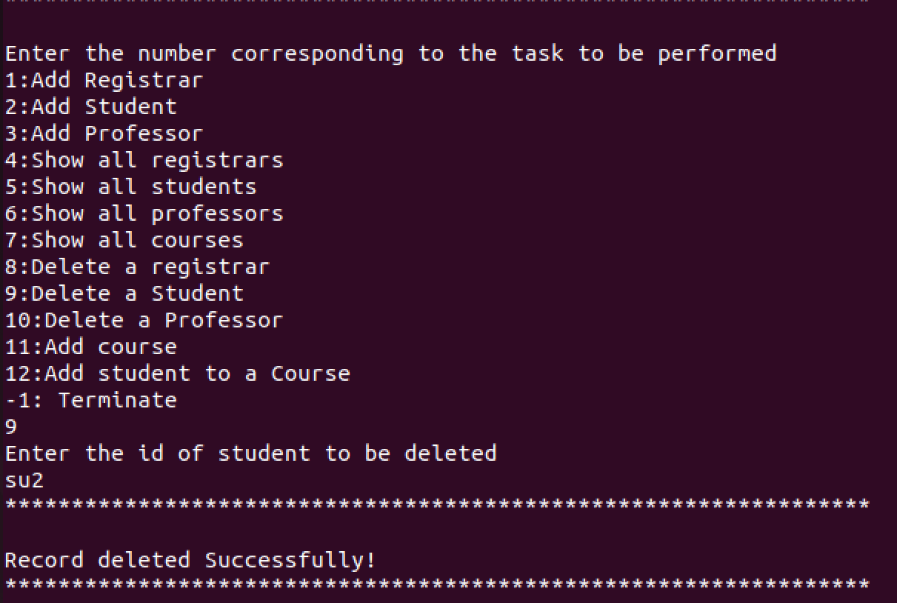
9. Delete a Student
Here the registrar deletes a student with a specific sid.
Sample Output
void deletestudent(string sid , sqlite3* DB)
{
int exit;
char* messaggeError;
string sql = "delete from student where id = '" + sid+"';"; cout<<"*****************************************************************\n\n"; exit = sqlite3_exec(DB, sql.c_str(), NULL, 0, &messaggeError);
if (exit != SQLITE_OK) {
std::cerr << "Error DELETE" << std::endl;
sqlite3_free(messaggeError);
}
else
std::cout << "Record deleted Successfully!\n";
cout<<"*****************************************************************\n\n";
}

Slide 18
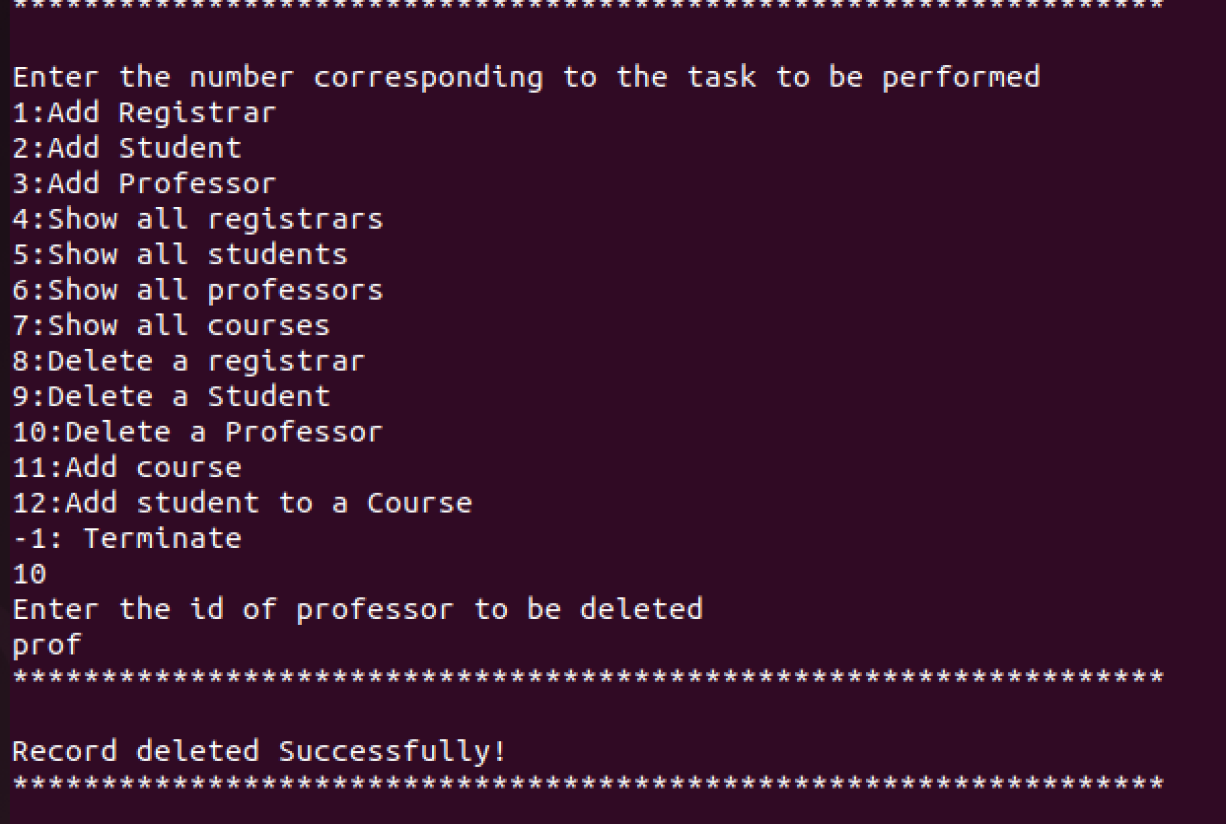
10. Delete a Professor
Registrar deletes a professor with a particular pid.
Sample Output
void deleteprof(string pid , sqlite3* DB)
{
int exit;
char* messaggeError; cout<<"*****************************************************************\n\n"; string sql = "delete from professor where id = '" + pid+"';";
exit = sqlite3_exec(DB, sql.c_str(), NULL, 0, &messaggeError); if (exit != SQLITE_OK) {
std::cerr << "Error DELETE" << std::endl;
sqlite3_free(messaggeError);
}
else
std::cout << "Record deleted Successfully!\n";
cout<<"*****************************************************************\n\n";
}

Slide 19
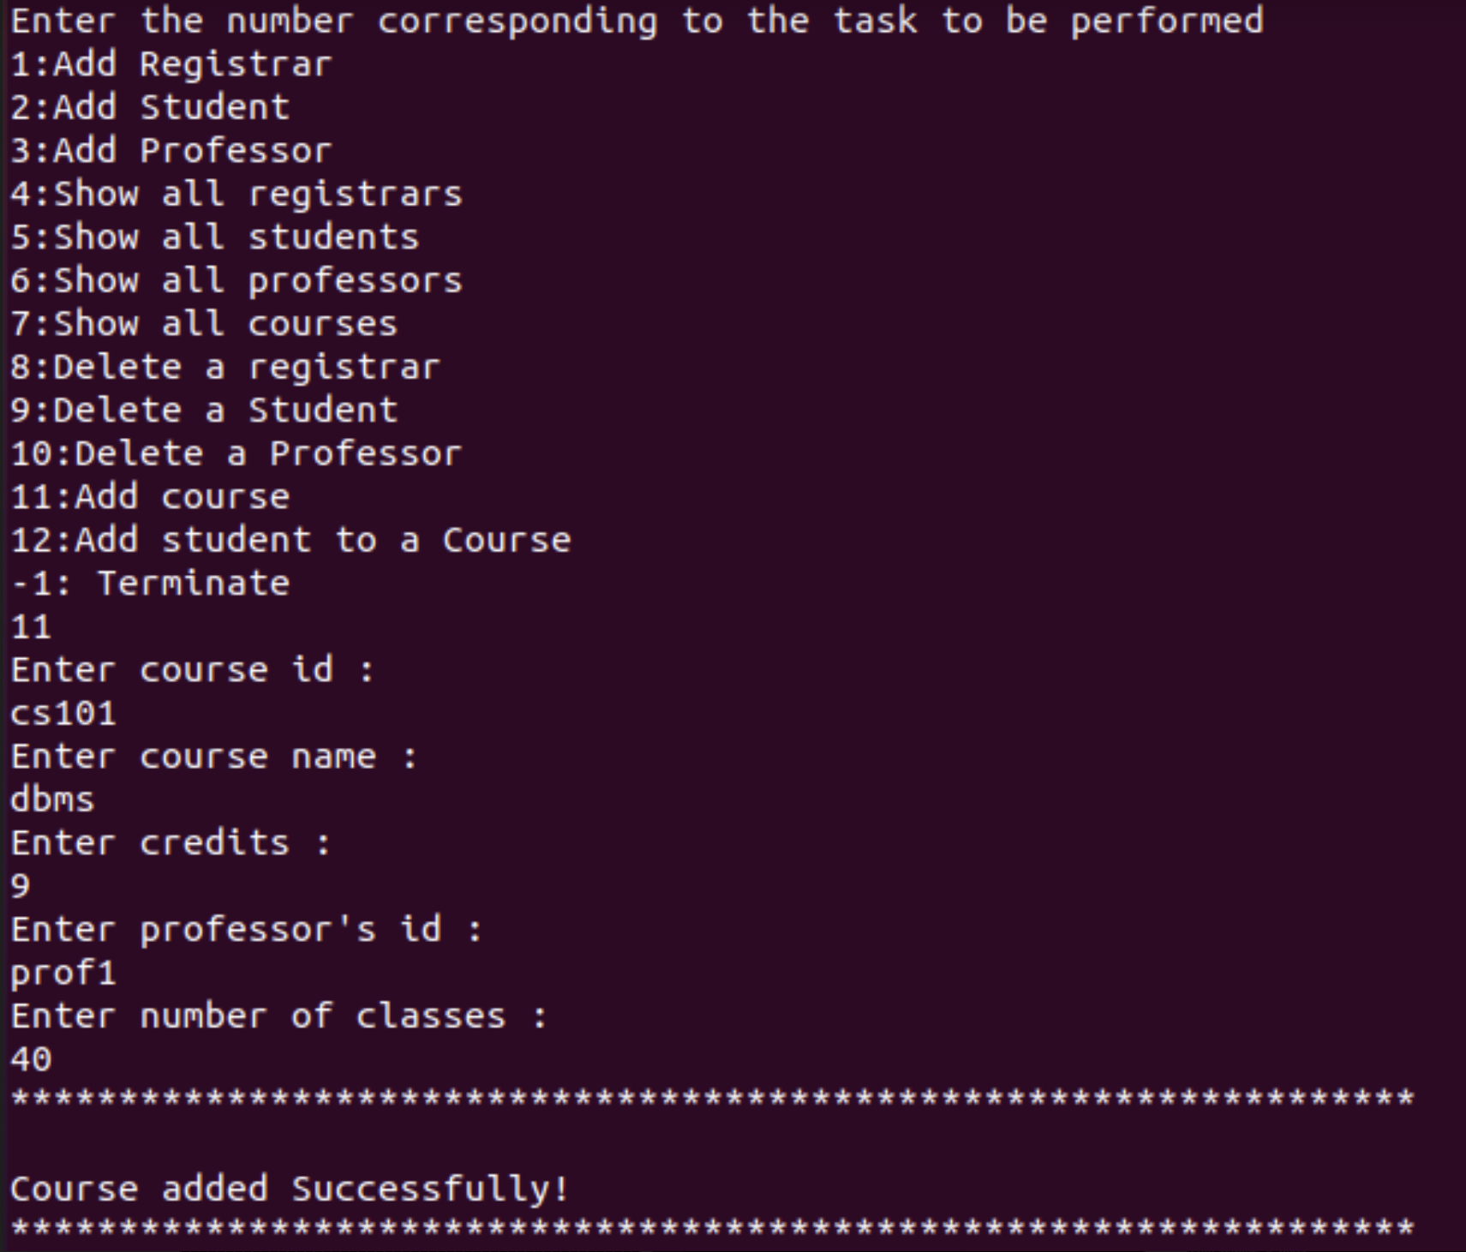
11. Add course
A new course is added to the course table. Id , name , credit , profid, no_of_classes are passed as parameter.
Sample Output
void add_course(string id,string name,string credit,string profid,string nc,sqlite3* DB)
{
char* messaggeError; int exit ;
string sql = "insert into course values('" + id +"', '" + name+ "', "+ credit +" , '"+ profid +"' , " + nc + ");";
cout<<"*****************************************************************\n\n"; exit = sqlite3_exec(DB, sql.c_str(), NULL, 0, &messaggeError);
if (exit != SQLITE_OK) {
std::cerr << "Error Insert" << std::endl; sqlite3_free(messaggeError);
}
else
std::cout << "Course added Successfully!" << std::endl; cout<<"*****************************************************************\n\n";
}

Slide 20
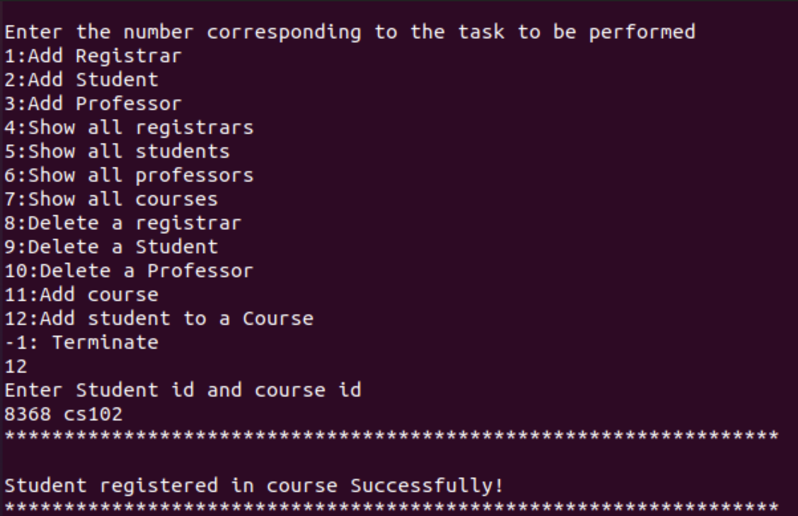
12. Add student to a course
A student is enrolled into a course using this function. Initially attendance and marks obtained are set to zero.
Sample Output
void add_student_in_course(string cid,string sid,string at,string mr,sqlite3* DB)
{
char* messaggeError; int exit ;
string sql = "insert into sturegist values('" + cid +"', '" + sid + "', "+ at +" , "+ mr +" );";
cout<<"*****************************************************************\n\n"; exit = sqlite3_exec(DB, sql.c_str(), NULL, 0, &messaggeError);
if (exit != SQLITE_OK) {
std::cerr << "Error Insert" << std::endl; sqlite3_free(messaggeError);
}
else
std::cout << "Student registered in course Successfully!" << std::endl; cout<<"*****************************************************************\n\n";
}

Slide 21
FUNCTIONS Accessed by Students

Slide 22
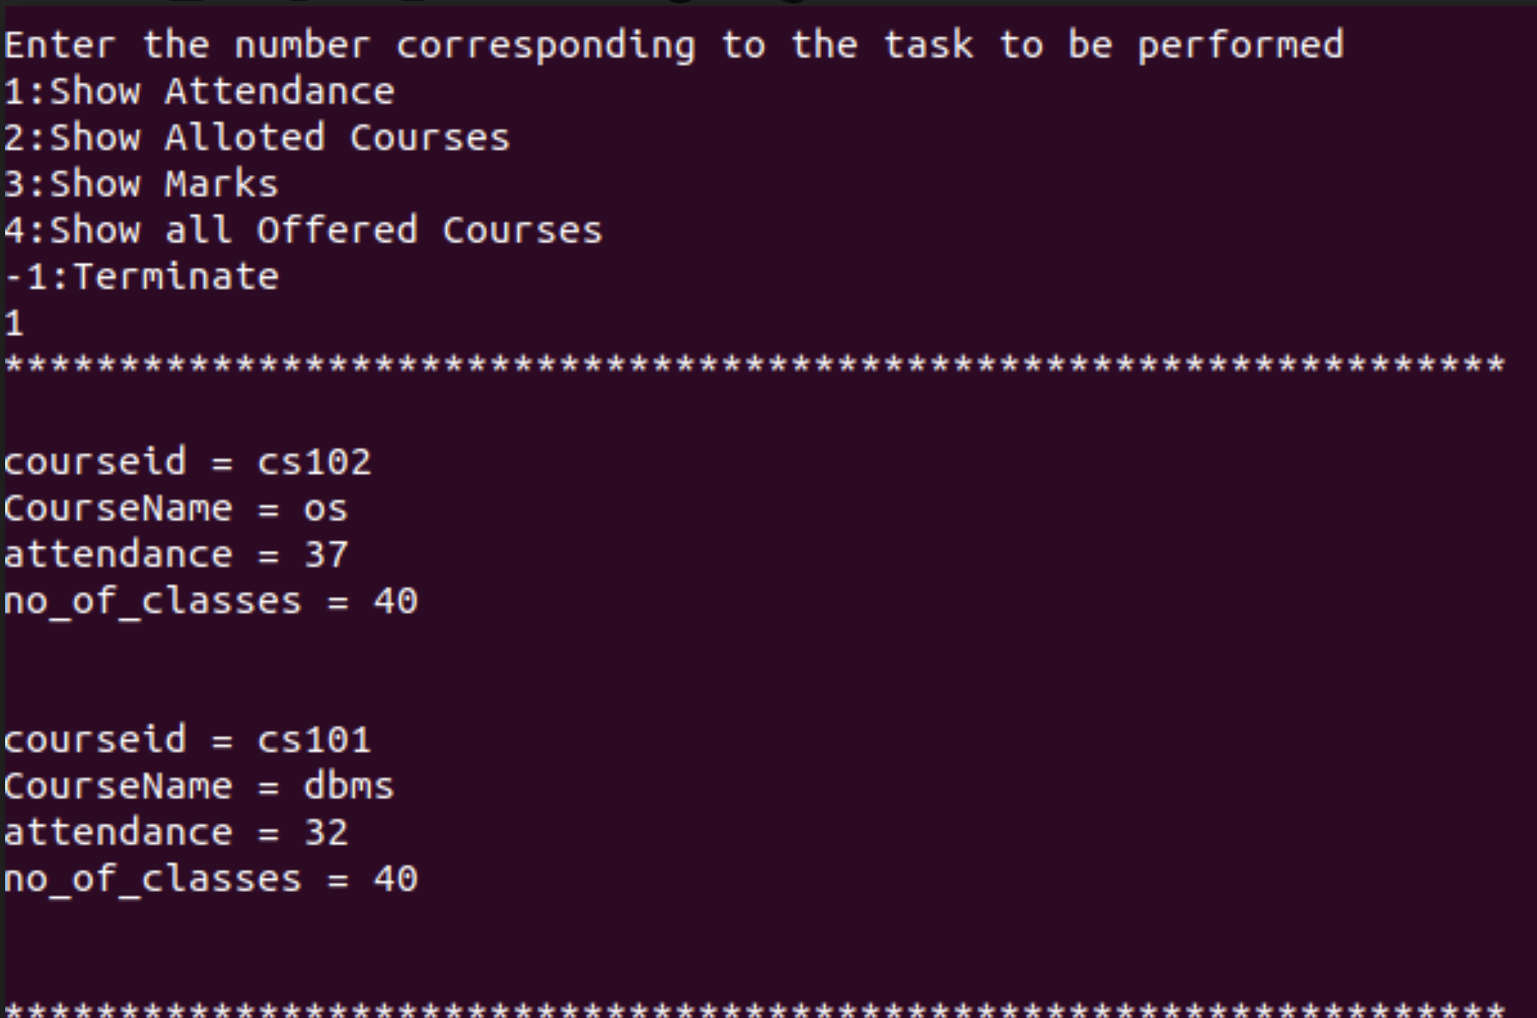
1. Show Attendance
This is used by a student to see his attendance in all the courses.
Sample Output
void showattendance(string sid,sqlite3* DB){
string sql = "select courseid , name as CourseName , attendance , no_of_classes from sturegist join course c on c.id = sturegist.courseid where studentid = '"+sid+"';";
cout<<"*****************************************************************\n\n"; sqlite3_exec(DB, sql.c_str(), callback, NULL, NULL); cout<<"*****************************************************************\n\n";
}

Slide 23
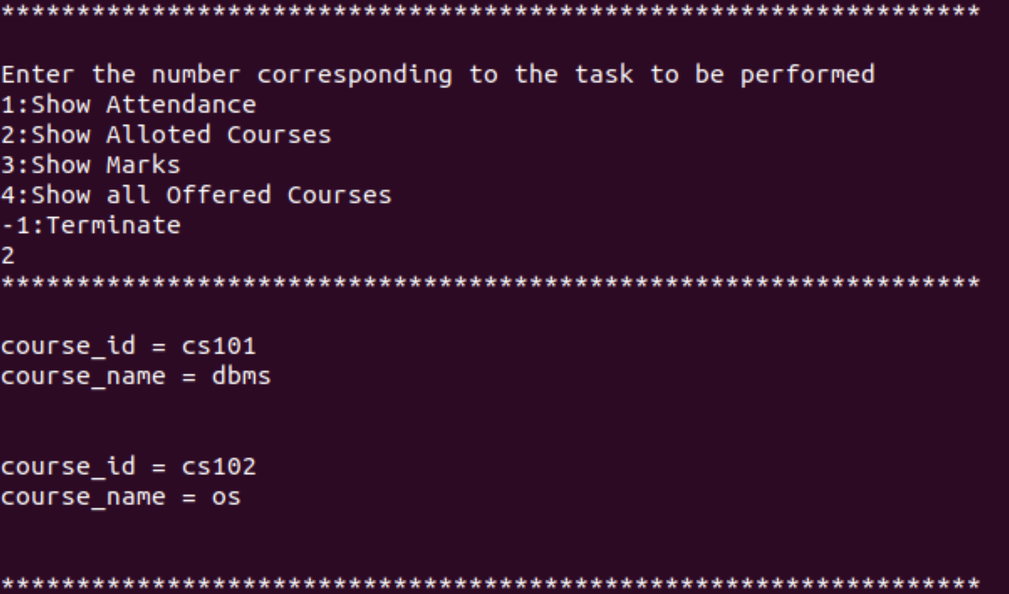
2. Show Allotted Courses
The student can see all the courses allocated to him with course id and name.
Sample Output
void showMycourses(string sid, sqlite3* DB){
string sql = "select course.id as course_id ,course.name as course_name from sturegist join course on courseid = course.id where studentid = '"+ sid+"';";
cout<<"*****************************************************************\n\n";
sqlite3_exec(DB, sql.c_str(), callback, NULL, NULL);
cout<<"*****************************************************************\n\n";
}

Slide 24
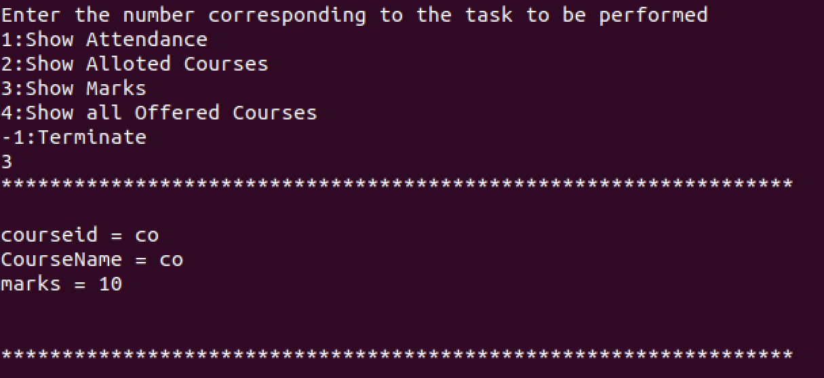
3. Show Marks
The student can view his marks obtained in all courses
Sample Output
void showmarks(string sid,sqlite3* DB){
string sql = "select courseid , name as CourseName , marks from sturegist join course c on c.id = sturegist.courseid where studentid = '"+sid+"';";
cout<<"*****************************************************************\n\n"; sqlite3_exec(DB, sql.c_str(), callback, NULL, NULL); cout<<"*****************************************************************\n\n";
}

Slide 25
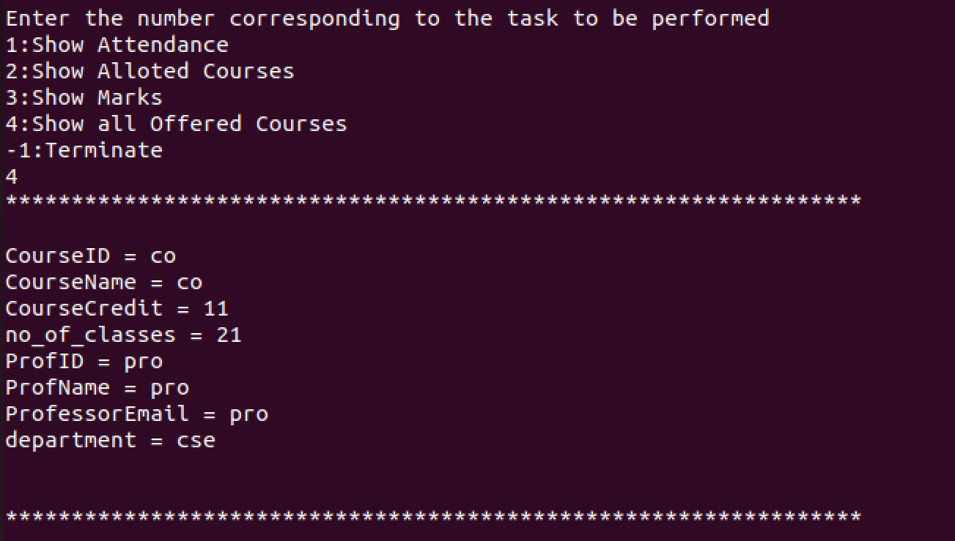
4. Show all offered courses
Student can see all the offered courses with details of the professor teaching it.
Sample Output
void showOfferedCourses(sqlite3* DB)
{
string query = "select course.id as CourseID, course.name as CourseName , credit as CourseCredit , no_of_classes , professor.id as ProfID , professor.name as ProfName , professor.email as ProfessorEmail , department from course join professor on course.prof_id = professor.id;";
cout<<"*****************************************************************\n\n"; sqlite3_exec(DB, query.c_str(), callback, NULL, NULL);
cout<<"*****************************************************************\n\n";
}

Slide 26
FUNCTIONS Accessed by PROFESSOR

Slide 27
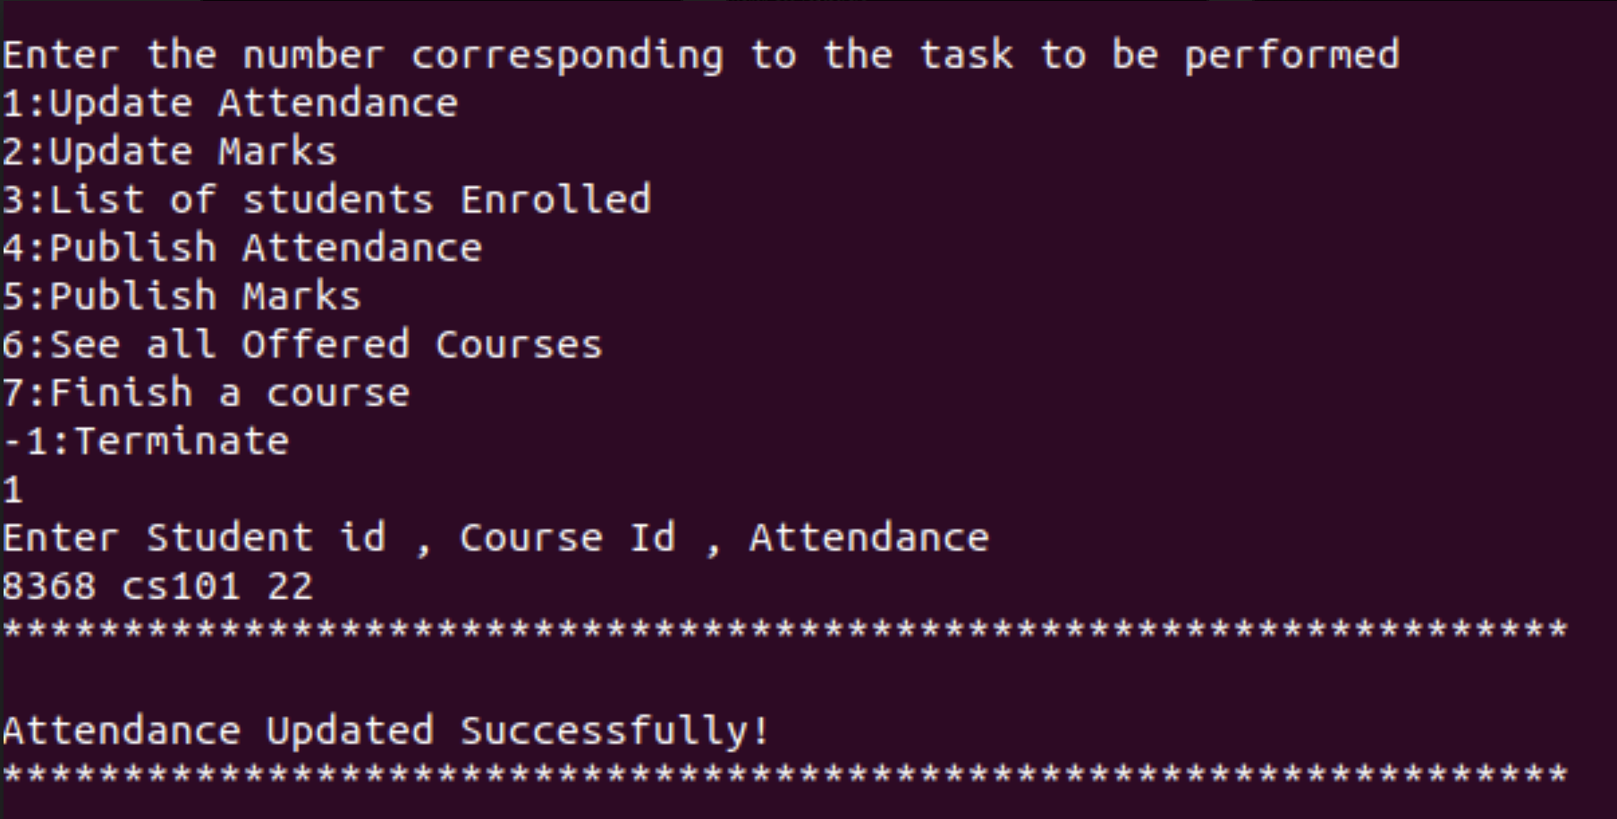
1. Update Attendance
The professor updates the attendance of a particular student in a particular course.
Sample Output
void updateattendance(string sid, string cid,string at,sqlite3* DB)
{
char* messaggeError; int exit ;
string sql = "update sturegist set attendance = "+ at +" where studentid = '" + sid
+ "' and courseid = '" + cid + "';";
cout<<"*****************************************************************\n\n"; exit = sqlite3_exec(DB, sql.c_str(), NULL, NULL, &messaggeError);
if (exit != SQLITE_OK) {
std::cerr << "Error Update" << std::endl; sqlite3_free(messaggeError);
// throw std::exception();
}
else
std::cout << "Attendance Updated Successfully!" << std::endl; cout<<"*****************************************************************\n\n";
}

Slide 28
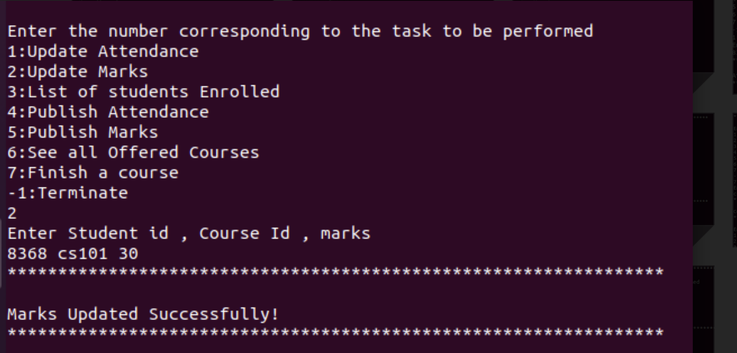
2. Update Marks
Professor updates a students marks in a particular course.
Sample Output
void updatemarks(string sid, string cid,string mr,sqlite3* DB)
{
char* messaggeError; int exit ;
string sql = "update sturegist set marks = " + mr + " where studentid= '" + sid + "' and courseid= '" + cid + "';";
cout<<"*****************************************************************\n\n"; exit = sqlite3_exec(DB, sql.c_str(), 0, NULL, &messaggeError);
if (exit != SQLITE_OK) {
std::cerr << "Error Update" << std::endl; sqlite3_free(messaggeError);
}
else
std::cout << "Marks Updated Successfully!" << std::endl; cout<<"*****************************************************************\n\n";
}

Slide 29
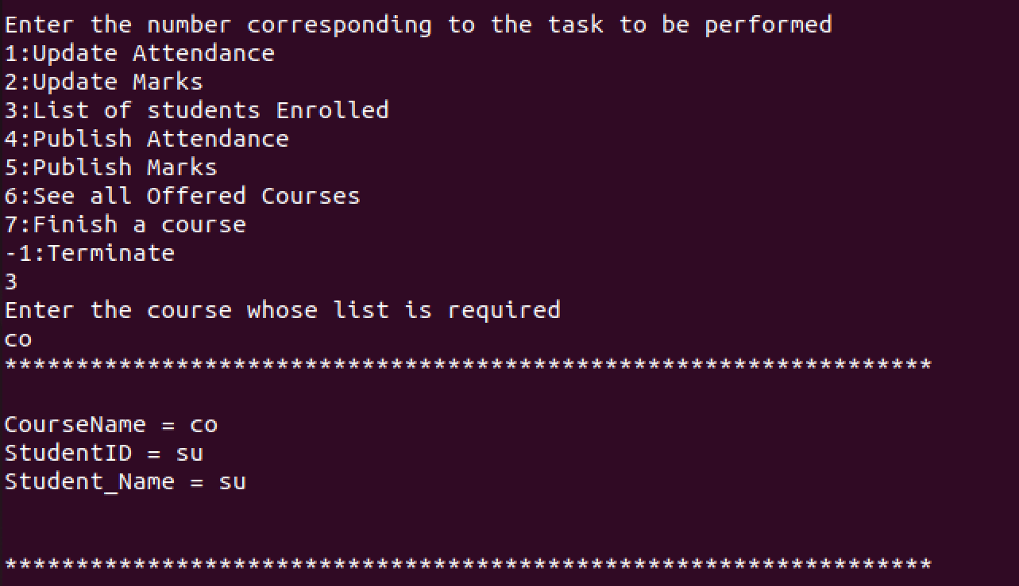
3. Get Enrolled List
Professor gets a list of all the students in his course.
Sample Output
void enrolleddlist(string cid , sqlite3* DB)
{
string sql = "select c.name as CourseName , studentid as StudentID , s.name as Student_Name from sturegist join course c on c.id = sturegist.courseid join student s on sturegist.studentid = s.id where c.id = '"+ cid +"';";
cout<<"*****************************************************************\n\n"; sqlite3_exec(DB, sql.c_str(), callback, NULL, NULL); cout<<"*****************************************************************\n\n";
}

Slide 30
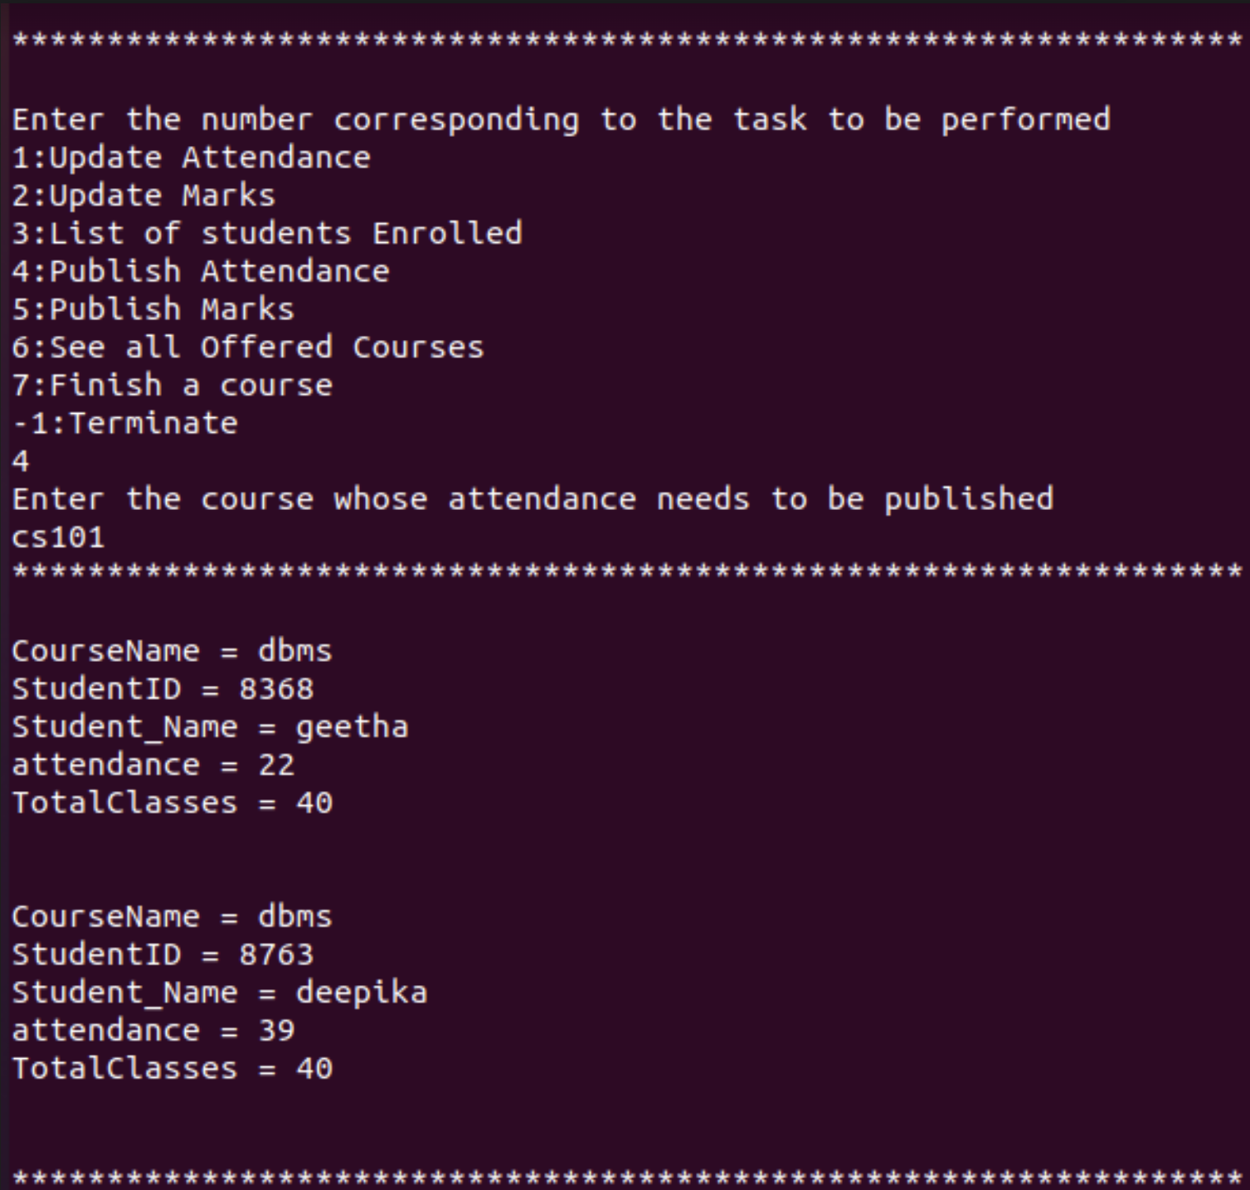
4. Publish attendance
Professor can publish the final attendance of a particulaR course.
Sample Output
void publishattendance(string cid , sqlite3* DB)
{
string sql = "select c.name as CourseName , studentid as StudentID , s.name as Student_Name , attendance , no_of_classes as TotalClasses from sturegist join course c on c.id = sturegist.courseid join student s on sturegist.studentid = s.id where c.id = '"+ cid +"';";
cout<<"*****************************************************************\n\n"; sqlite3_exec(DB, sql.c_str(), callback, NULL, NULL); cout<<"*****************************************************************\n\n";
}

Slide 31
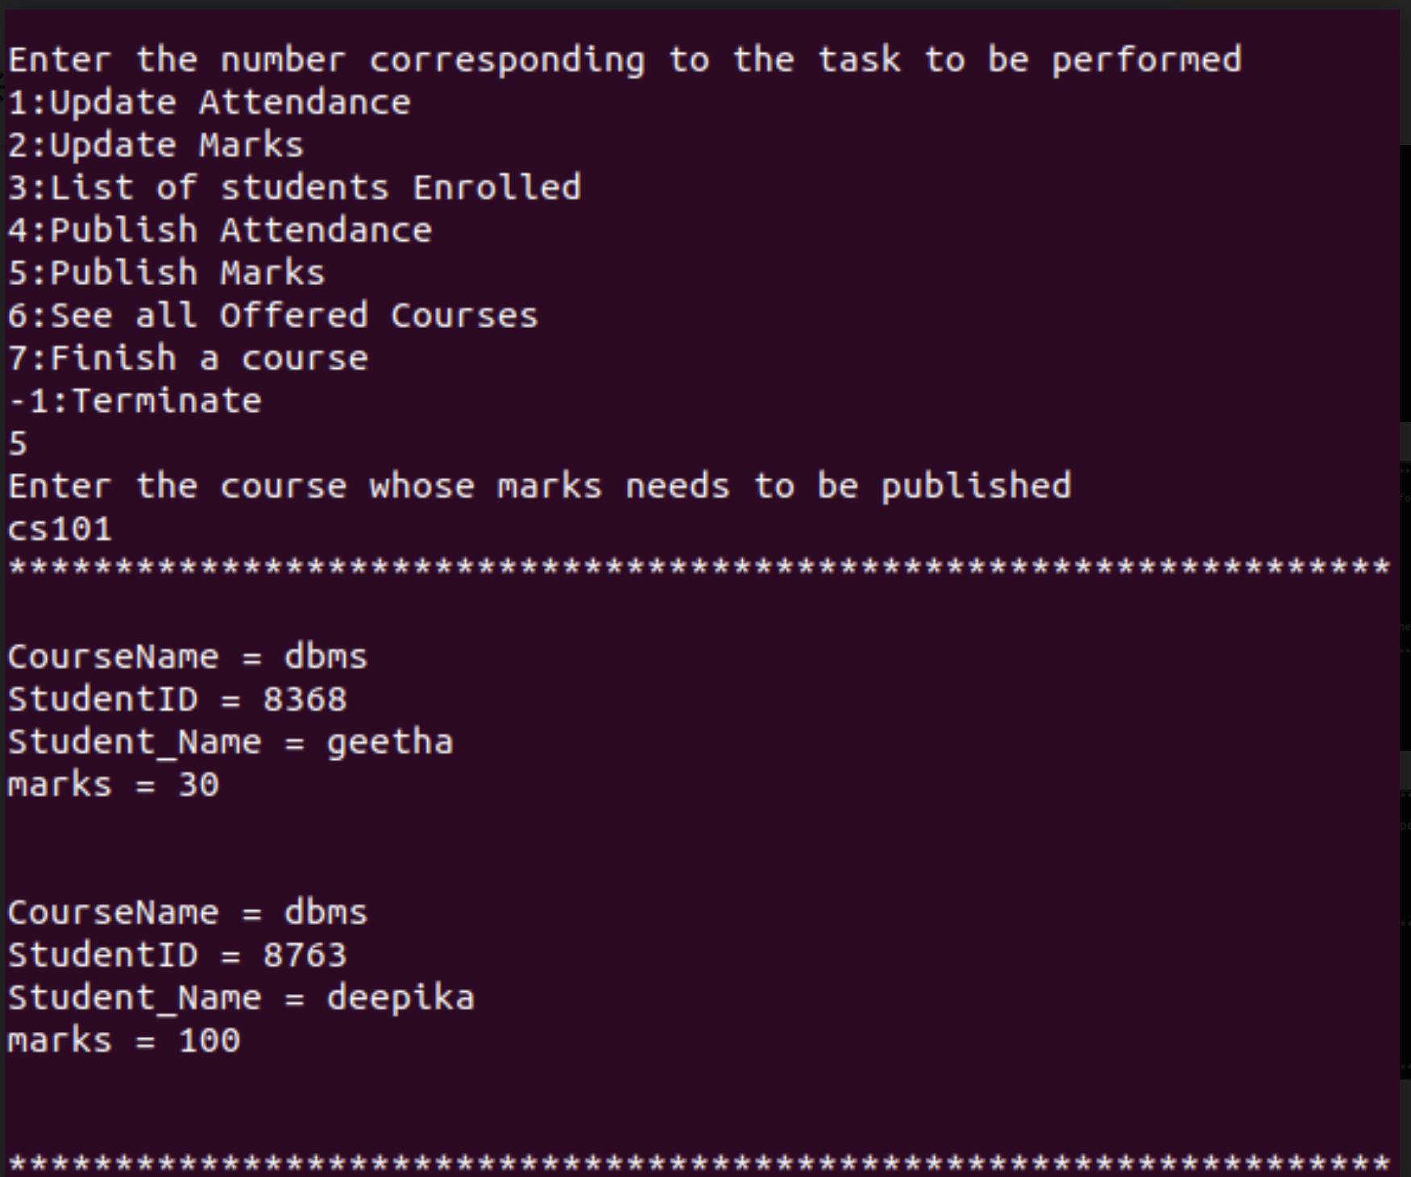
5. Publish Marks
Professor publishes the final marks obtained by all the students in a course.
Sample Output
void publishmarks(string cid , sqlite3* DB)
{
string sql = "select c.name as CourseName , studentid as StudentID , s.name as Student_Name , marks from sturegist join course c on c.id = sturegist.courseid join student s on sturegist.studentid = s.id where c.id = '"+ cid +"';";
cout<<"*****************************************************************\n\n"; sqlite3_exec(DB, sql.c_str(), callback, NULL, NULL); cout<<"*****************************************************************\n\n";
}

Slide 32
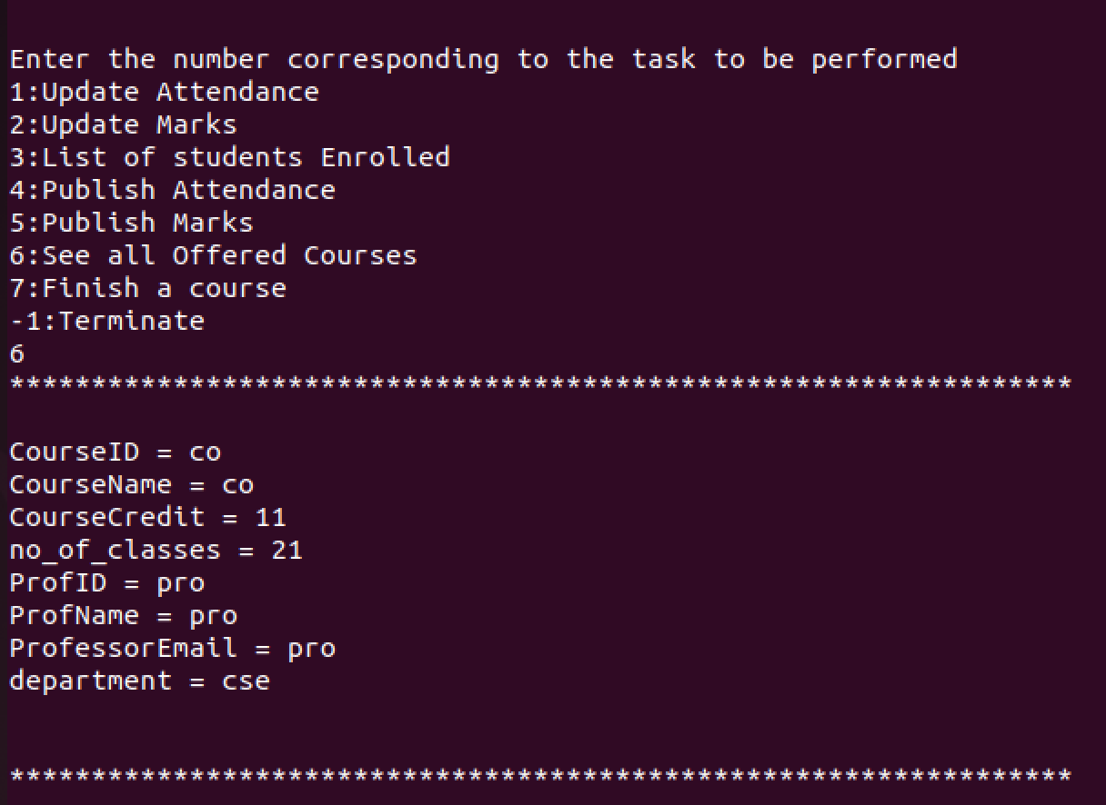
6. Show all offered courses
PROFESSOR can see all the offered courses with details of the professor teaching it.
Sample Output
void showOfferedCourses(sqlite3* DB)
{
string query = "select course.id as CourseID, course.name as CourseName , credit as CourseCredit , no_of_classes , professor.id as ProfID , professor.name as ProfName , professor.email as ProfessorEmail , department from course join professor on course.prof_id = professor.id;";
cout<<"*****************************************************************\n\n"; sqlite3_exec(DB, query.c_str(), callback, NULL, NULL);
cout<<"*****************************************************************\n\n";
}

Slide 33
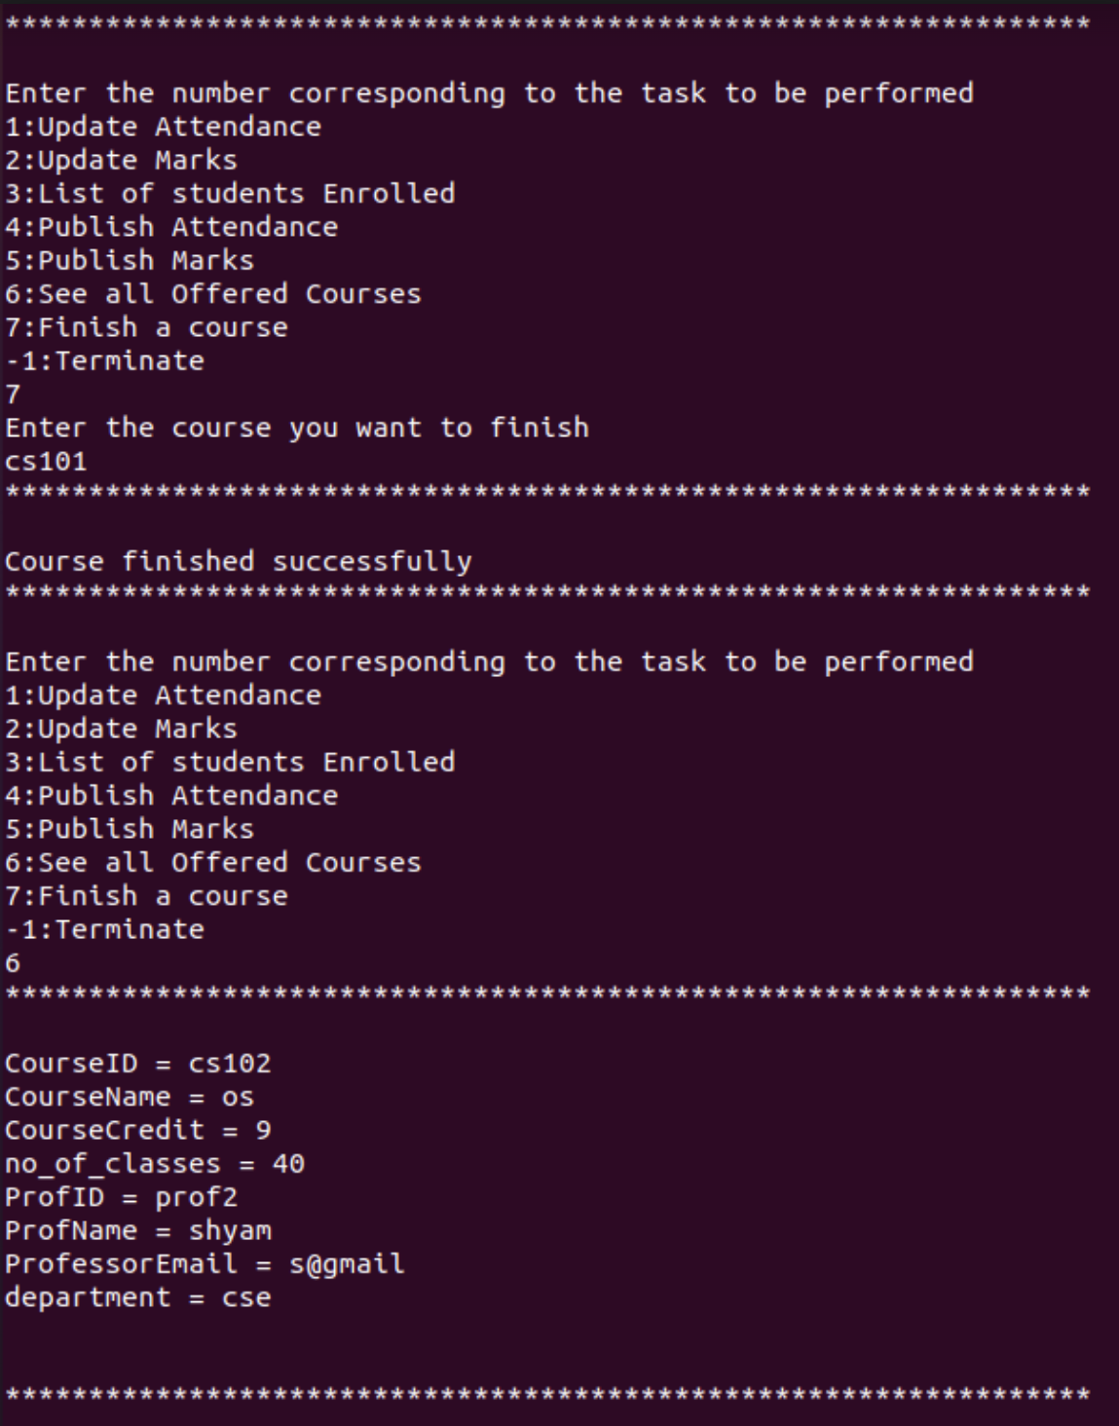
7. Finish a Course
Professor can mark a course as finished and remove the course from the sturegist table and course table.
Sample Output
void finishcourse(string cid , sqlite3* DB)
{
int exit;
char* messaggeError; cout<<"*****************************************************************\n\n"; string sql = "delete from sturegist where courseid = '" + cid+"';";
exit = sqlite3_exec(DB, sql.c_str(), NULL, 0, &messaggeError); if (exit != SQLITE_OK) {
std::cerr << "Error DELETE" << std::endl;
sqlite3_free(messaggeError); return;
}
sql = "delete from course where id ='" + cid+"';";
exit = sqlite3_exec(DB, sql.c_str(), NULL, 0, &messaggeError); if (exit != SQLITE_OK) {
std::cerr << "Error DELETE" << std::endl; sqlite3_free(messaggeError);
}
else
std::cout<< "Course finished successfully\n"; cout<<"*****************************************************************\n\n";
}

Slide 34
DEMO VIDEO

Slide 35
Future Enhancements
Detail update
Support for individual user to update his details.
Minimum percentage support
Support add minimum percentage attendance support missing which you will be given zero marks and hence deemed fail.
Grade allocation
Allocation of grades on the basis of marks obtained.
GPA CALCULATION
Support for GPA calculation on the basis of marks and credits.

Slide 36
Conclusion
After completing the project we successfully implemented terminal based interface for registrar , professor and students who are the entities of our model. Have also added all the basic functionalities of all the entities with support of error catching. We used SQLite3 which is an embedded SQL Library and integrated it with C++ to get the required product delivered.

Slide 37
THANK YOU

